Slide 1

S.Sai Harini
19L31A05C3

Slide 2
Contents
What is Block chain?
Distributed ledger technology
Working mechanism of block chain
Types of block chain
Career opportunities in block chain
Block chain developer
Advantage of block chain
Disadvantages of block chain

Slide 3
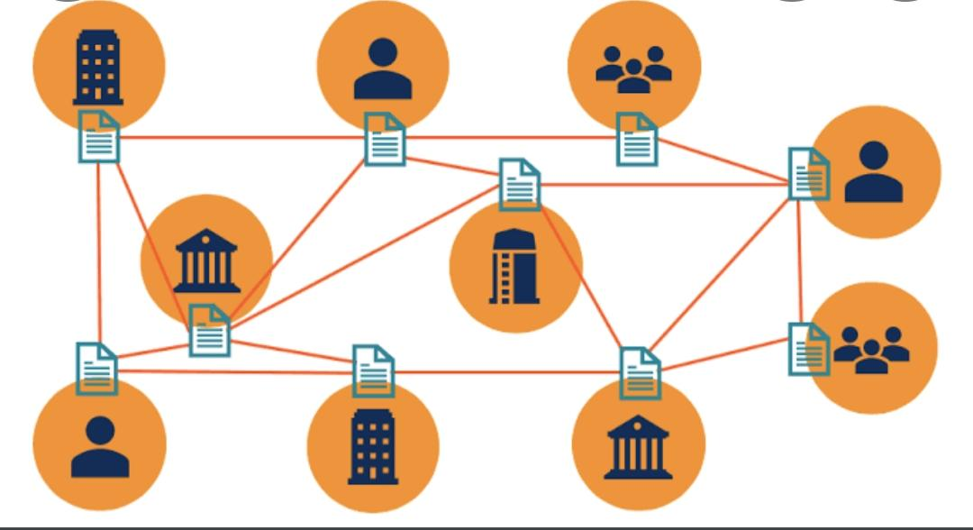
Ledger

Slide 4

Features of Block chain technology

Slide 5
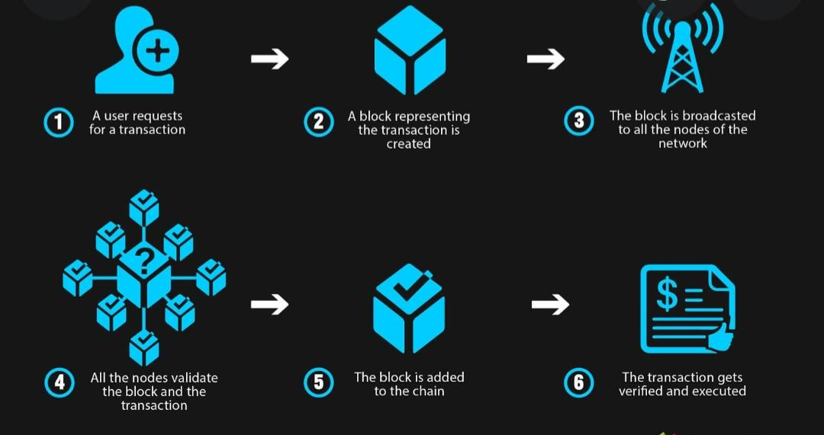
Working mechanism of block chain

Slide 6
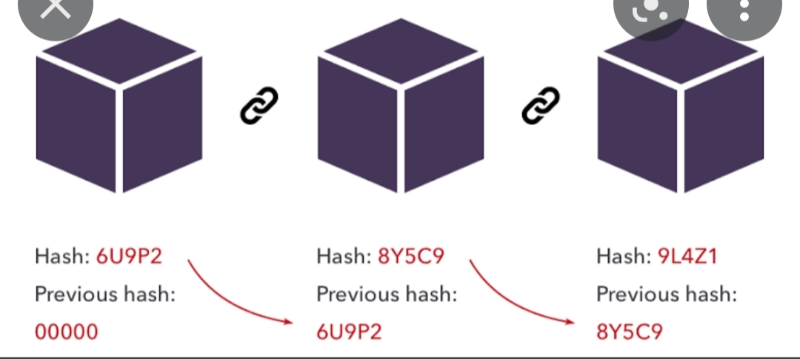
Working of hash function

Slide 7
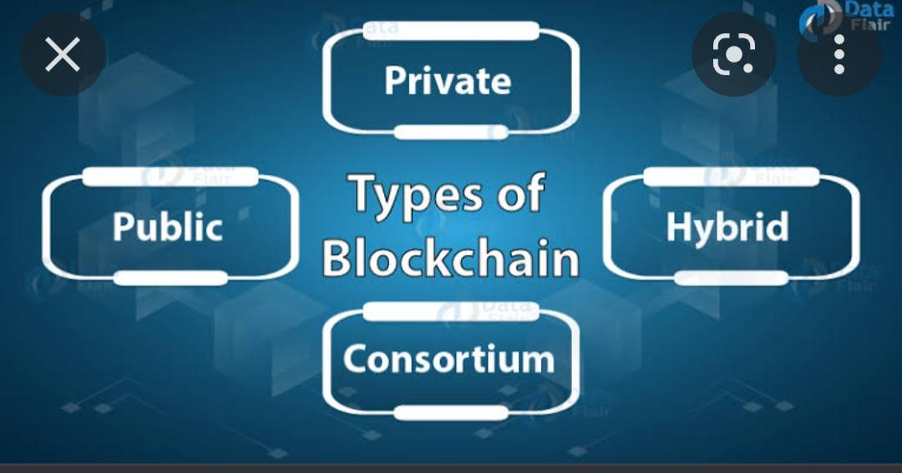
Types of block chain

Slide 8
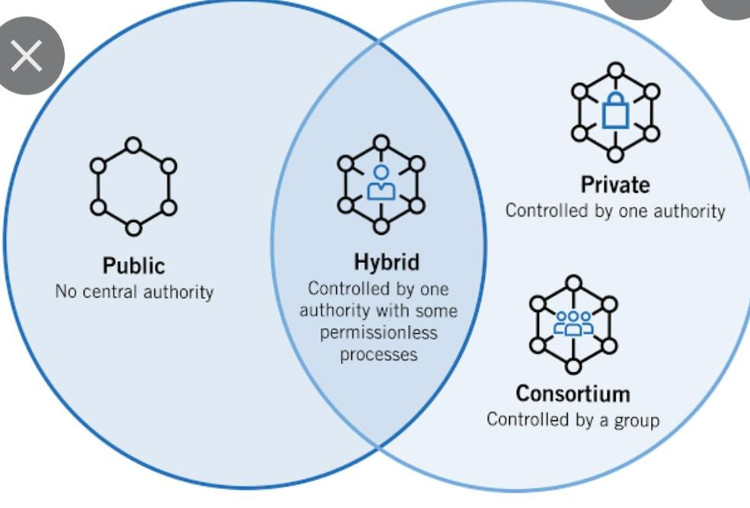

Slide 9
Public Block chain
Public blockchain is non-restrictive and permissionless, and anyone with internet access can sign on to a blockchain platform to become an authorized node.
Advantange : Network transparency and they are completely independent of organisations
Disadvantages: The network can be slow, and companies can't restrict access or use.
Uses: Cryptocurrency, documentation and validation.

Slide 10

Bitcoin

Slide 11
Private block chain
A blockchain network that works in a restrictive environment like a closed network, or that is under the control of a single entity, is a private blockchain.
Advantages:The controlling organization sets permission levels, security, authorizations and accessibility.
Disadvantages: Users can't independently audit or confirm it, which can lead to less security.
Uses: supply chain and assert ownership

Slide 12
Hybrid block chain
A type of blockchain technology that combines elements of both private and public blockchain. It lets organizations set up a private, permission-based system alongside a public permissionless system, allowing them to control who can access specific data stored in the blockchain, and what data will be opened up publicly.
Advantages: One of the big advantages of hybrid blockchain is that, because it works within a closed ecosystem, outside hackers can't mount a 51% attack on the network.
Disadvantages: This type of blockchain isn't completely transparent because information can be shielded.
Uses: real estate and medical records

Slide 13
Consotorium block chain
A consortium blockchain is a private blockchain with limited access to a particular group, eliminating the risks that come with just one entity controlling the network on a private blockchain.
Advantages: secure, scalable and efficient
Disadvantages: less transparent and impair network functionality
Uses: Banking and Payments

Slide 14

Etherum Ethereum is a decentralized blockchain platform that establishes a peer-to-peer network that securely executes and verifies application code, called smart contracts.

Slide 15

Career opportunities in block chain

Slide 16
Block chain developer
A blockchain developer has the knowledge and skill-set to develop and optimize decentralized applications or dApps and smart contracts like 3D modelling,3D design and 3D content development
Types of block chain developer: Core block chain developers and blockchain software developers
Technologies: blocks ,c++,python Ethereum ,neo ,hyperledger

Slide 17
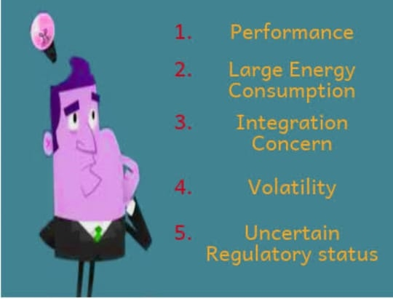
Advantages

Slide 18
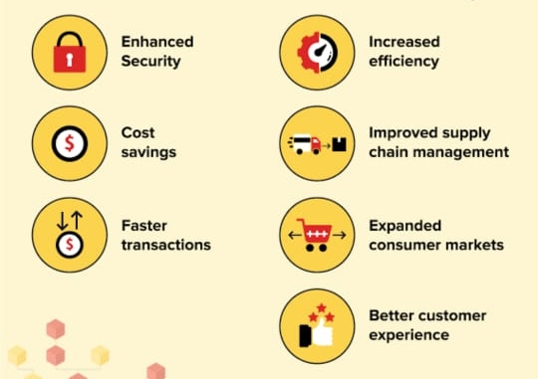
Disadvantages

Slide 19

Worldwide spending on blockchain solutions

Slide 20

Applications

